Slide 1
Prediction of optical waveguide parameters using CNN
Reporter/Team Member: Xuan Chen
Student #82286956

Slide 2
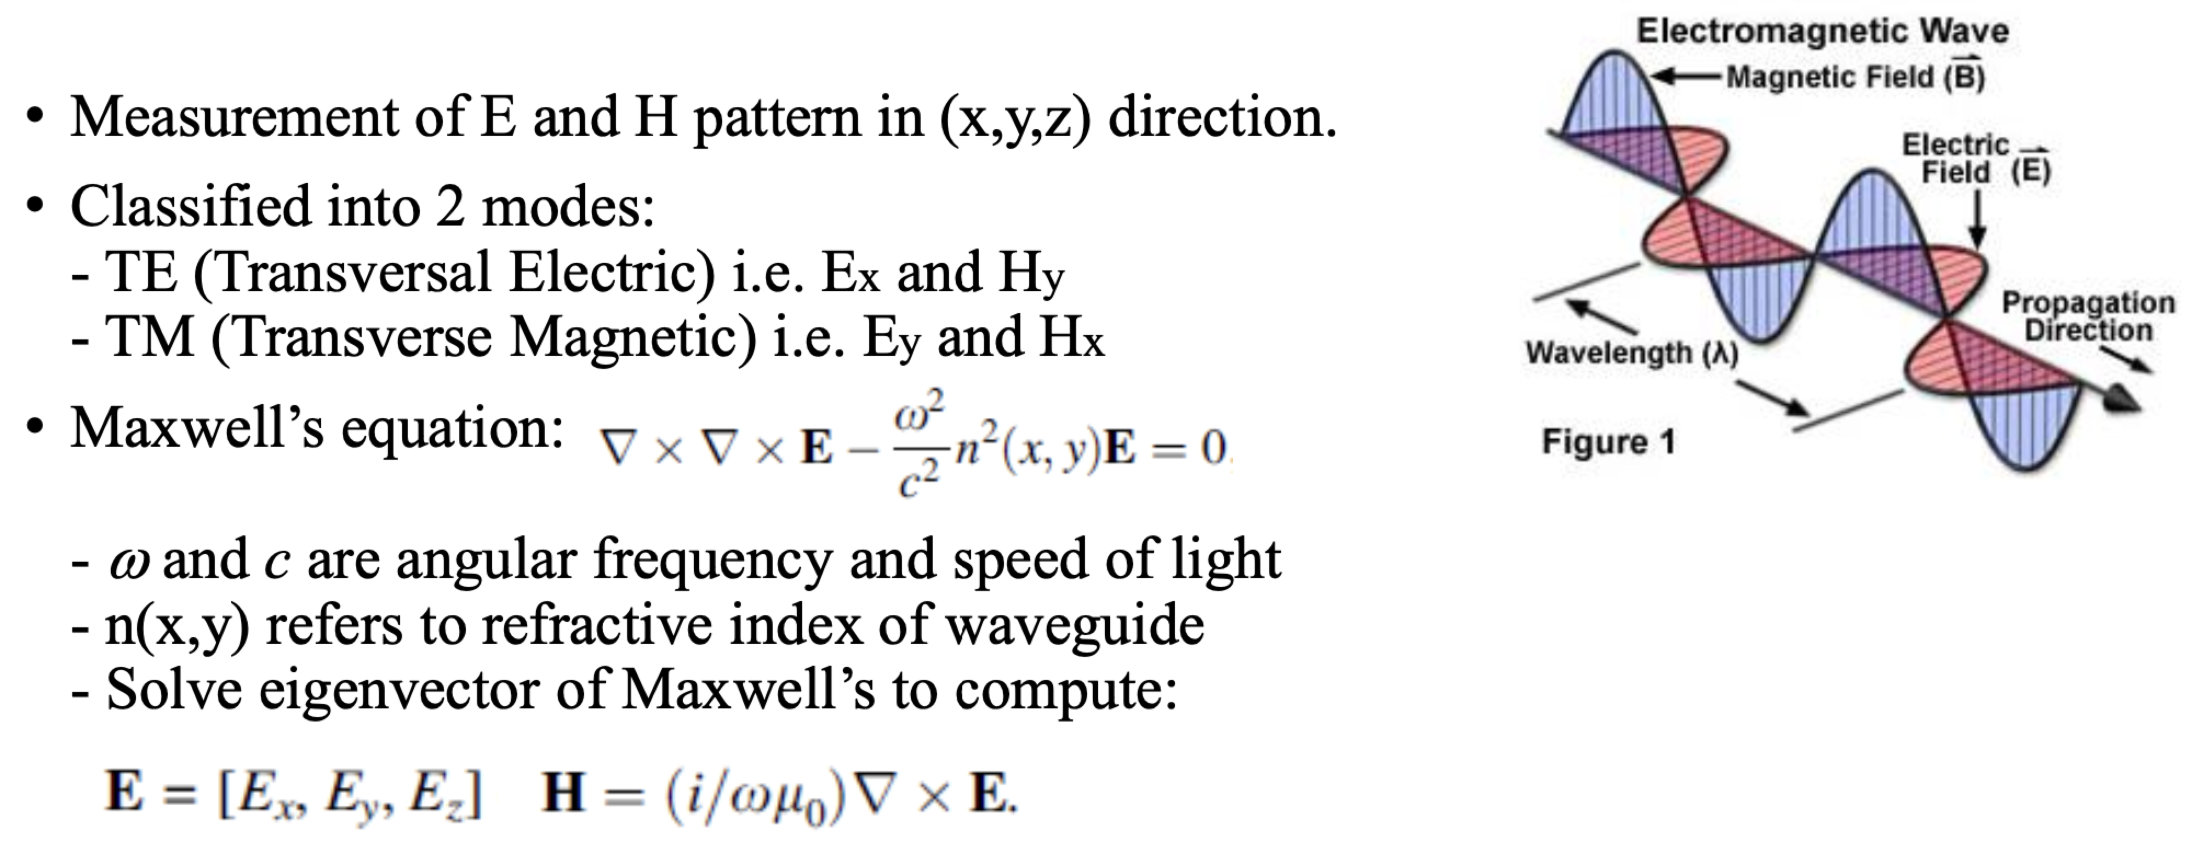
Electromagnetic field patterns of optical waveguide
Application in main research:::
Used as a part of detection system to discover the leakage at gas station.

Slide 3
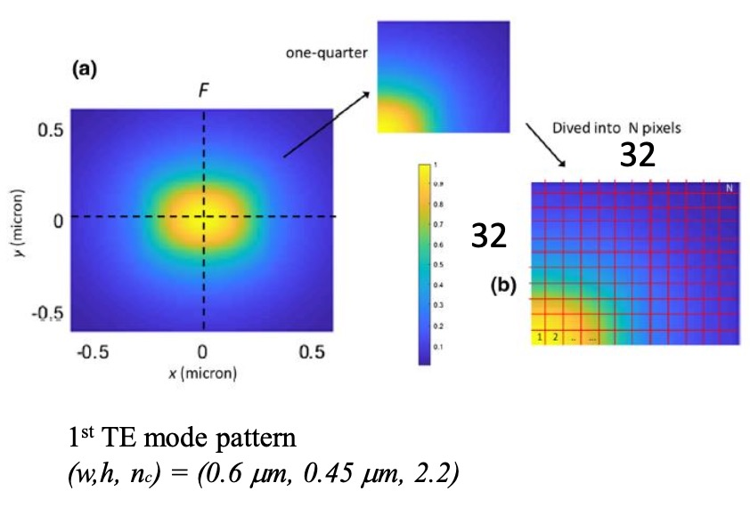
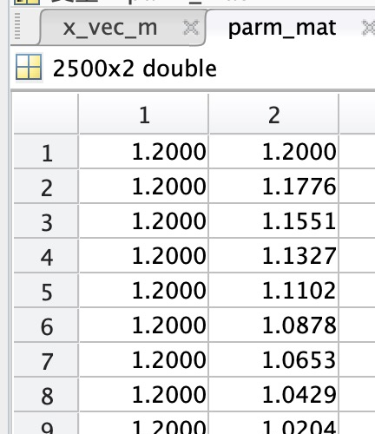
What am I doing? Using CNN models to predict optical waveguide parameters.
Input: Extract one-quarter of mode pattern image and discretize into 28x28 pixels.
Output: geometric dimensions w (0.1 ~ 1.2𝜇m) h (0.1 ~ 1.2𝜇m)

Slide 4
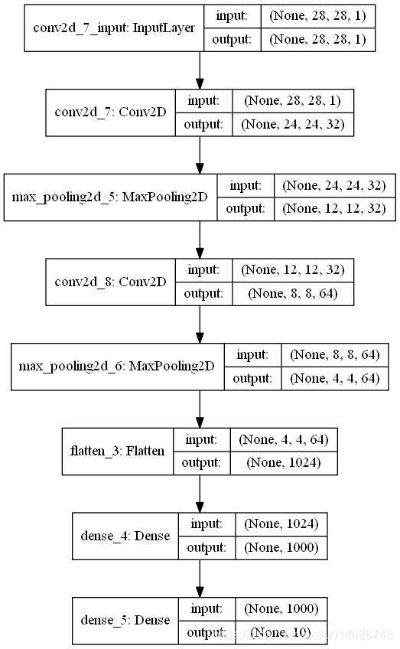
Overview of model
CNN + LSTM model (might need to be adjusted)
Other parameter: Epoch = 2000 (Iteration times of training model). Batch size = 10 (Number of samples updated by gradient)
2

Slide 5
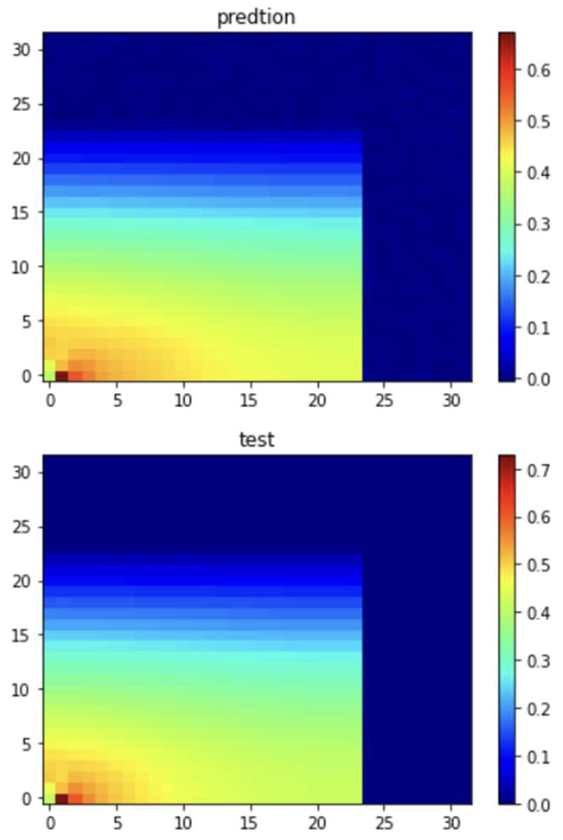
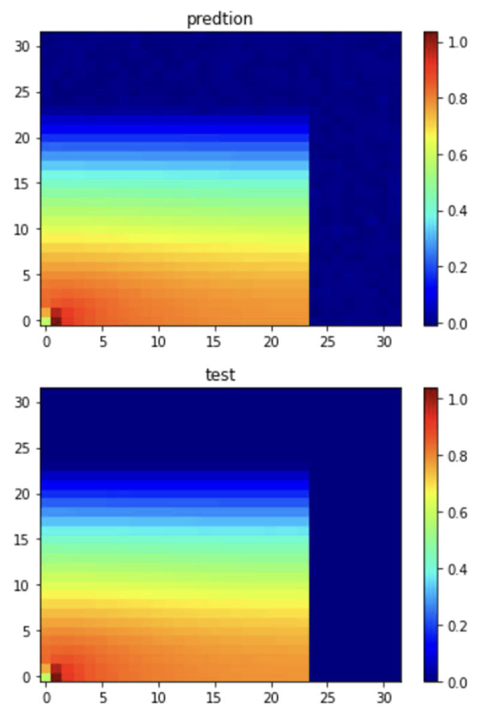
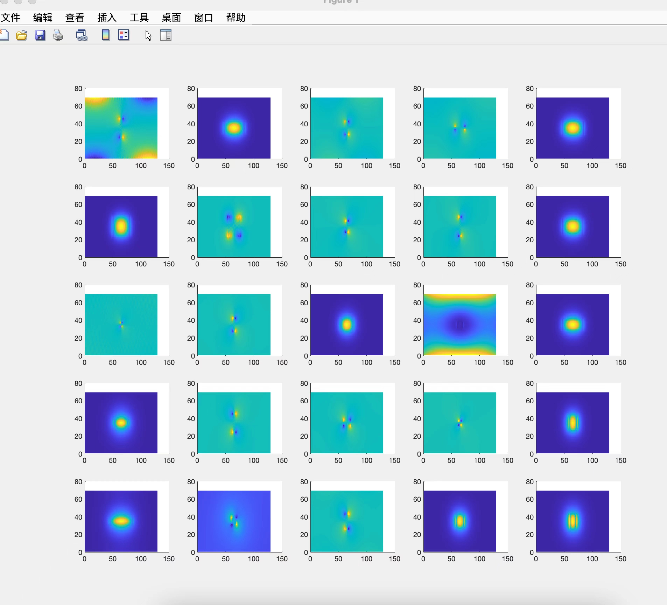
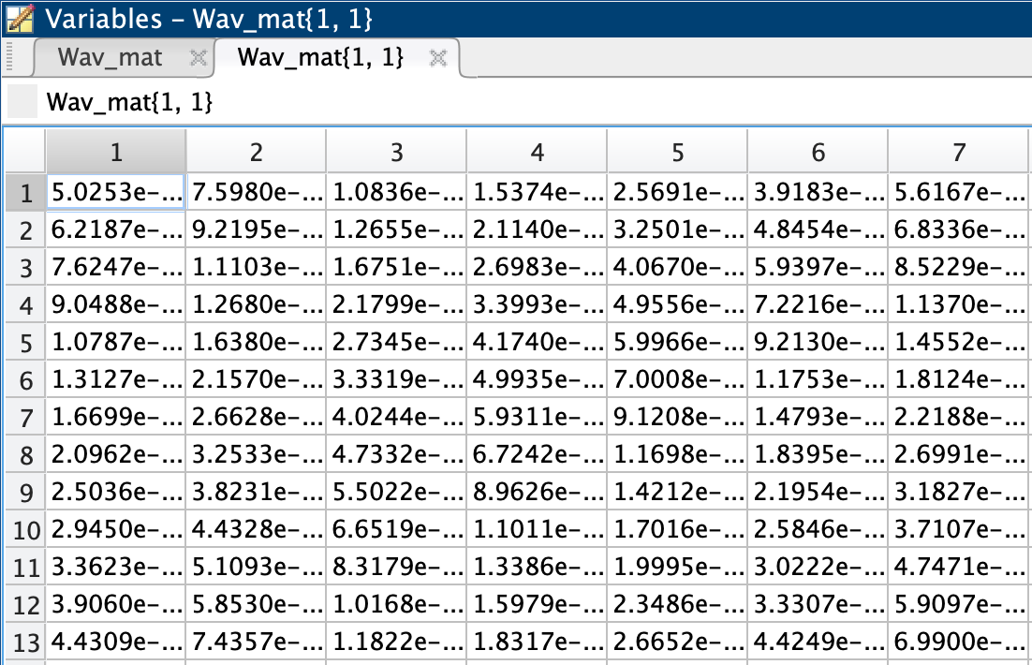
Dataset
Training dataset size: 20k (30% labeled)
Validation dataset size: 2k

Slide 6
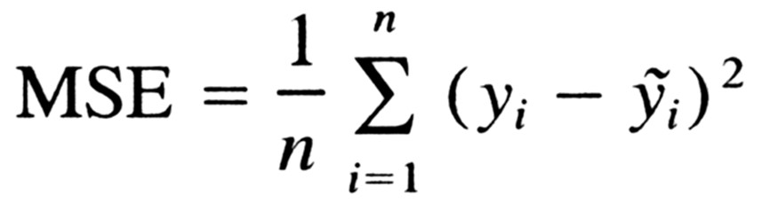
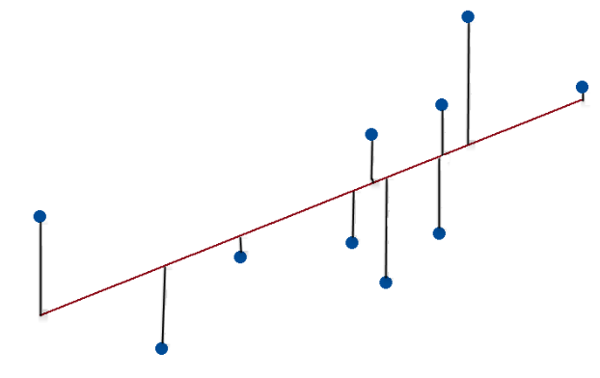
Evaluation
Evaluate the validation error by validation dataset.
Loss function: MSE (exact & predict)
Mean squared error (MSE) measures the amount of error in statistical models. It assesses the average squared difference between the observed and predicted values. When a model has no error, the MSE equals zero. As model error increases, its value increases.
In regression, the mean squared error represents the average squared residual. As the data points fall closer to the regression line, the model has less error, decreasing the MSE. A model with less error produces more precise predictions.

Slide 7
Timeline
Time | Plan
Oct 20 | Search information and documents.
Oct 27 | Pre-processing datasets.
Oct 30 | Prepare slides.
Nov 3 | Presentation.
Nov 9 | Proposal.
Nov 20 | Build prediction models.
Nov 25 | Finish code part and start final report.
Dec 4 | Modify report and finish it.

Slide 8
Reference
Alagappan, G.; Ong, J.R.;Yang, Z.; Ang, T.Y.L.; Zhao,W.; Jiang,Y.; Zhang,W.; Png, C.E. Leveraging AI in Photonics and Beyond. Photonics 2022, 9, 75. https://doi.org/10.3390/photonics9020075
C. M. Chew and W. H. Weedon, “A 3d perfectly matched medium from modified Maxwell’s equations with stretched coordinates”, Microwave and Optical Tech. Lett., vol. 7, No. 13, pp. 599-604, 1994
https://pyimagesearch.com/2019/02/04/keras-multiple-inputs-and-mixed-data/
AI4D Proposal: Deep learning optimization of frequency microcomb

